Slide 1



AI POWERED -
HEALTHCARE MANAGEMENT
SYSTEM 2024 - 2025
Transforming Healthcare Management
GenAI-2024-2025-B2-00X
GenAI-2024-2025-B2

Slide 2
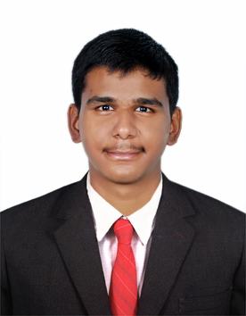
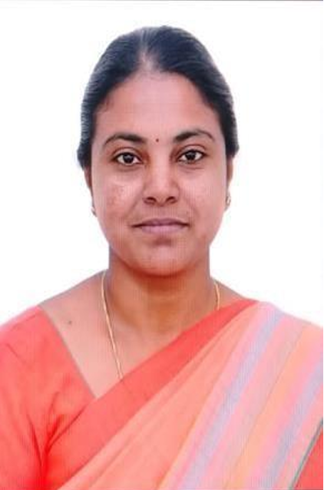
AI Powered HMS
GenAI-2024-2025-B2-00X
Team Information
Anand. G
Student Team
2024-2025, M.E CSE
SNS College of Technology
Application Development
Name. Initial
Name. Initial
Dr. K. Sangeetha
Faculty
DT Mentor
Technology Mentor
Project Guide

Slide 3
AI Powered HMS
GenAI-2024-2025-B2-00X
Project Overview
Requirement / Problem statement
Streamlining the healthcare appointment process with an efficient digital booking and management platform.
Description
The project addresses the need for an improved healthcare appointment system. The application provides a digital platform for booking medical appointments and managing healthcare practices, including features like online scheduling, patient communication, and practice management. This enhances accessibility to healthcare services and boosts the efficiency of medical practices.
Scope
GenAI | AI
Develop a comprehensive app for patient registration to consultation, using AI for voice input, report generation, appointment booking, and treatment suggestions. Focus on user-friendly experience, data security, and compliance.
Report generation, appointment analysis, treatment suggestions.
Key factors & features
Target Audience
Domain
Voice input for patient data
AI-generated medical reports
Intelligent appointment booking
Doctor's dashboard with treatment and medicine suggestions
Patient portal for accessing records
Patients
Doctors
Healthcare providers
Healthcare
AI
Medical Technology

Slide 4
AI Powered HMS
GenAI-2024-2025-B2-00X
Project Features
Project Features / Journeys
Voice Input using NLP
Patient Registration and Data Management
Medical Report Generation with Generative AI
Intelligent Appointment Booking
Doctor's Dashboard for Treatment Planning
Suggest Medicine based on Diabetic Type
Patient Portal for Record Access and Management

Slide 5
AI Powered HMS
GenAI-2024-2025-B2-00X
Technology Stack
Presentation Layer
Methodology
Technologies: StreamLit
Agile Development
Application Layer
Products, Tools & Utilities
Technologies: Python
IDE: PyCharm
AI Model: LLAMA-3.2-Vision
Data Layer
Infrastructure
Technologies: JSON File, EMR, MongoDB Compass
Data Storage: JSON File, EMR, MongoDB
Development Environment: PyCharm as the IDE for developing the application.
Source Code
API
Project code repository is available at Link
NIL
Note: Artefacts locations are provided as clickable hyperlink available as “Link”

Slide 6
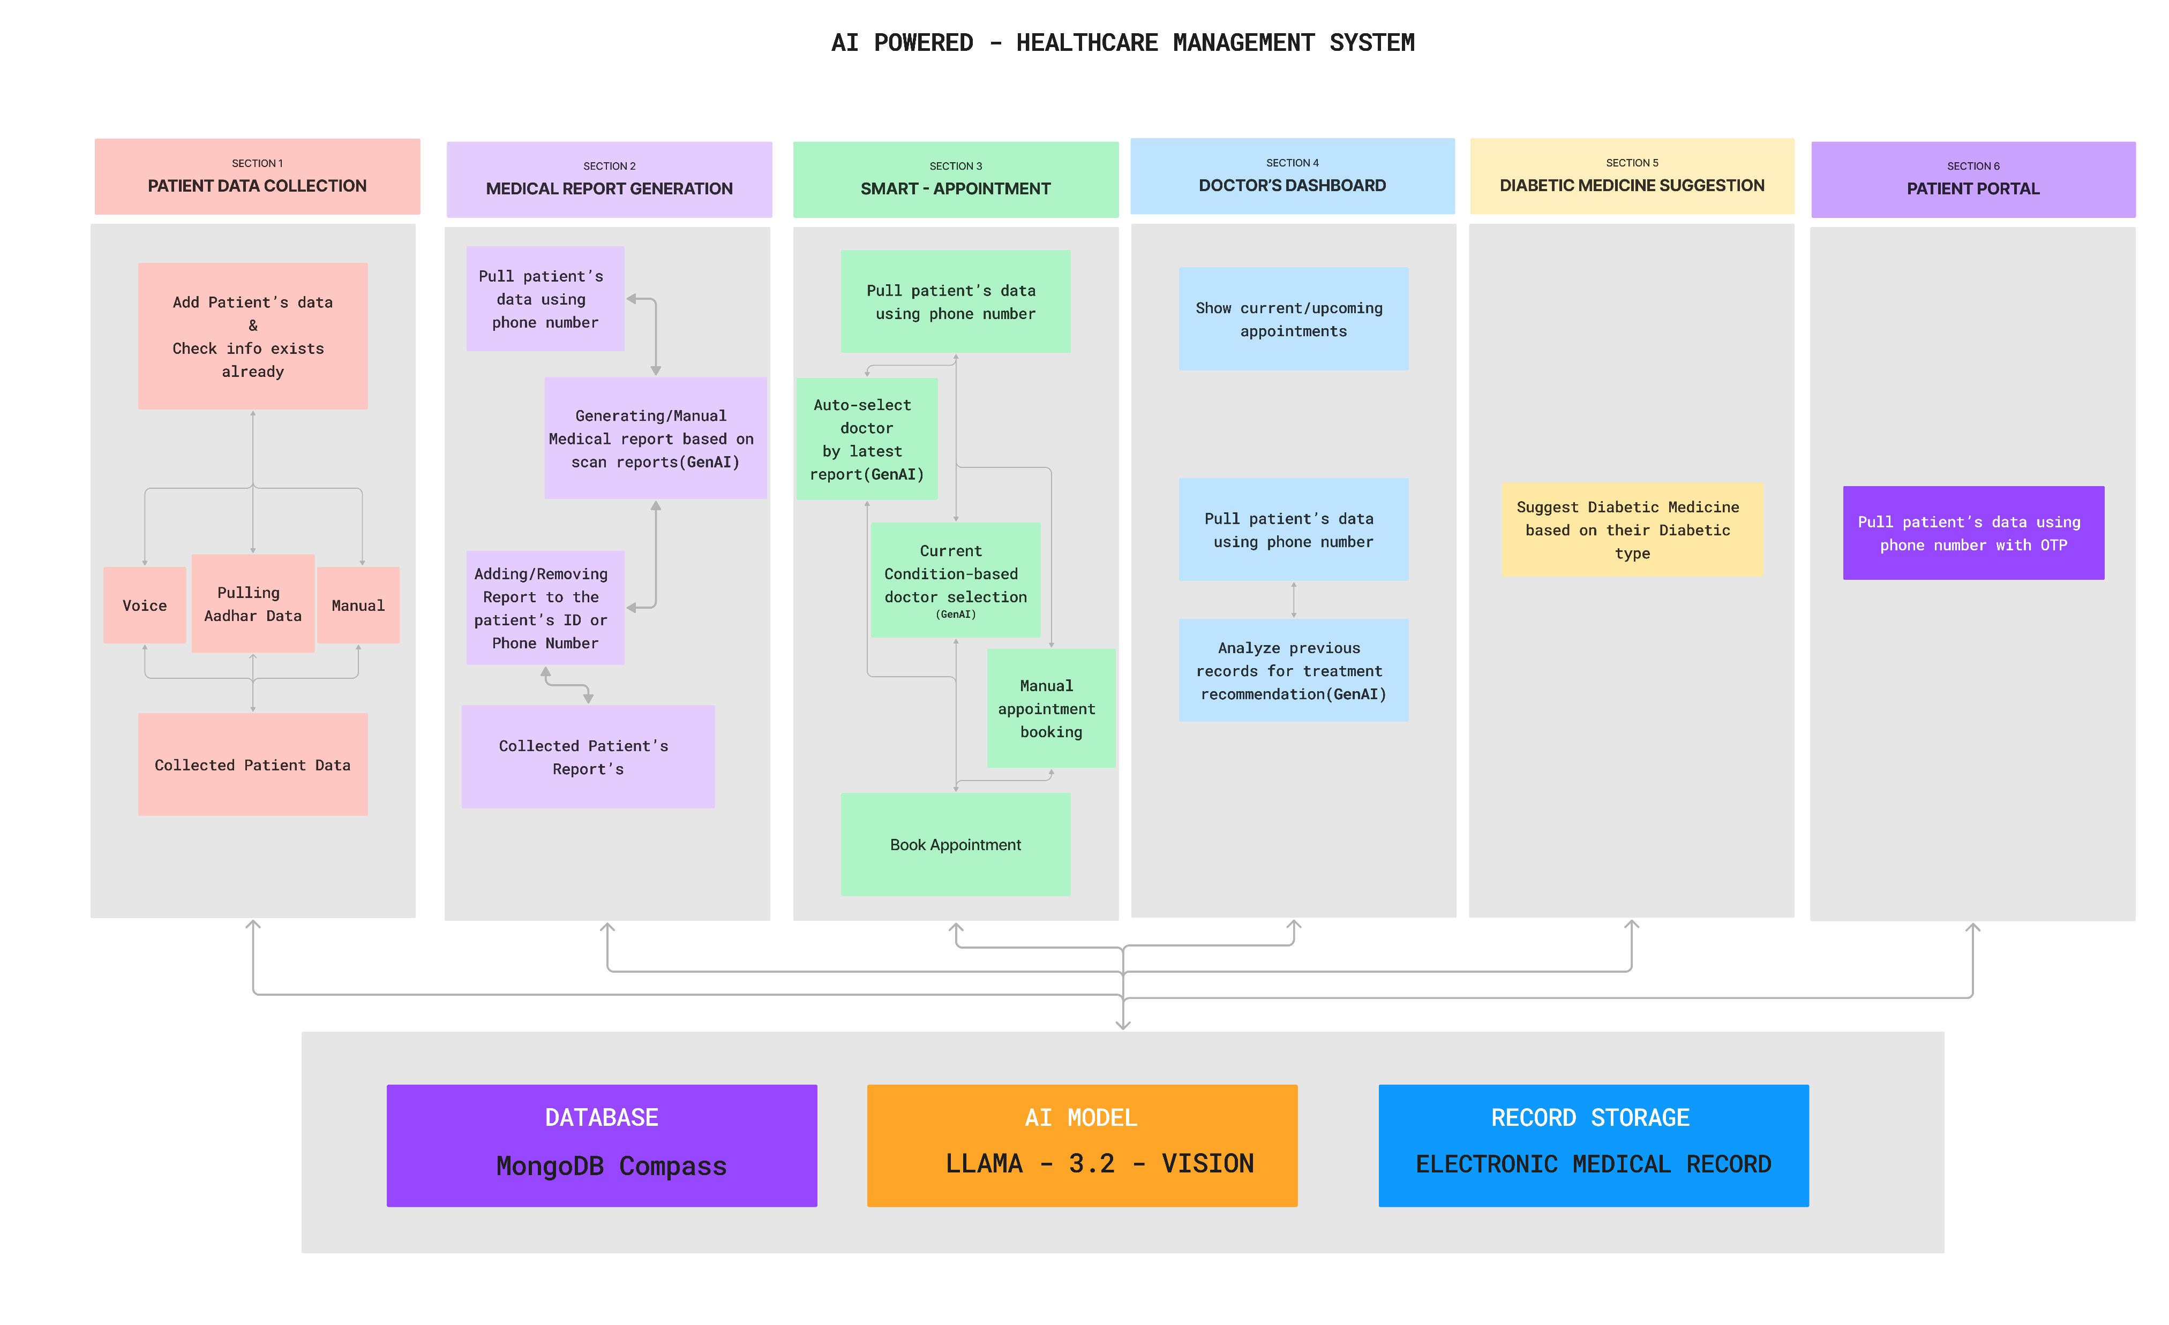
AI Powered HMS
GenAI-2024-2025-B2-00X
Wireframe | UI
Wireframe | UI
Dashboard – Complete Flow

Slide 7

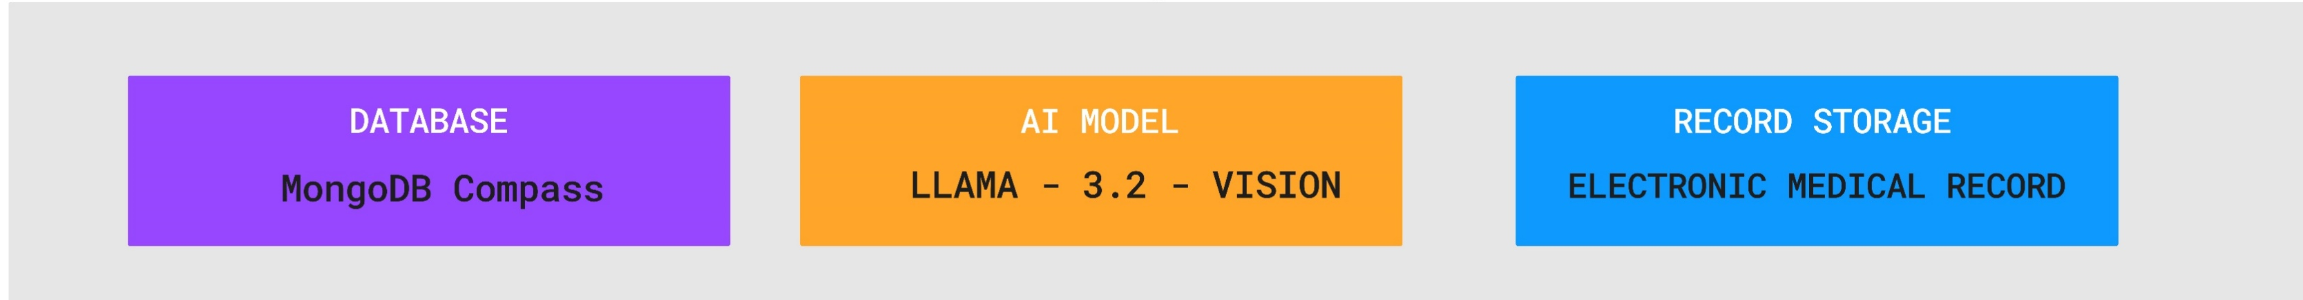
AI Powered HMS
GenAI-2024-2025-B2-00X
Wireframe | UI
Wireframe | UI
Dashboard – Patient Data Collection Page

Slide 8

AI Powered HMS
GenAI-2024-2025-B2-00X
Wireframe | UI
Wireframe | UI
Dashboard – Report Control Page

Slide 9
AI Powered HMS
GenAI-2024-2025-B2-00X
Wireframe | UI
Wireframe | UI
Dashboard – Smart Appointment page

Slide 10
AI Powered HMS
GenAI-2024-2025-B2-00X
Wireframe | UI
Wireframe | UI
Dashboard – Doctor Dashboard

Slide 11
AI Powered HMS
GenAI-2024-2025-B2-00X
Wireframe | UI
Wireframe | UI
Dashboard – Doctor Dashboard

Slide 12

AI Powered HMS
GenAI-2024-2025-B2-00X
Wireframe | UI
Wireframe | UI
Dashboard – Patient Portal Page

Slide 13
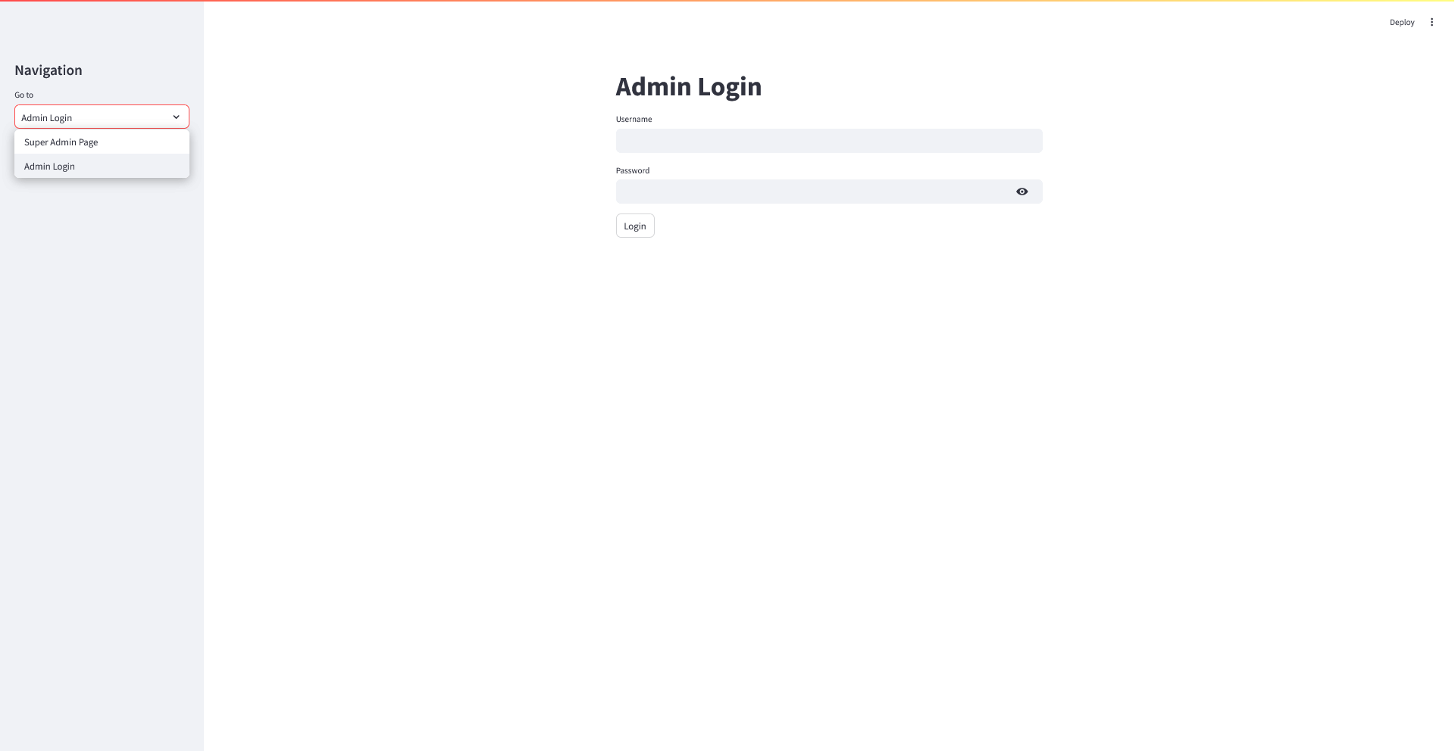
AI Powered HMS
GenAI-2024-2025-B2-00X
Application Screenshots
ADMIN/SUPER ADMIN LOGIN PAGE

Slide 14
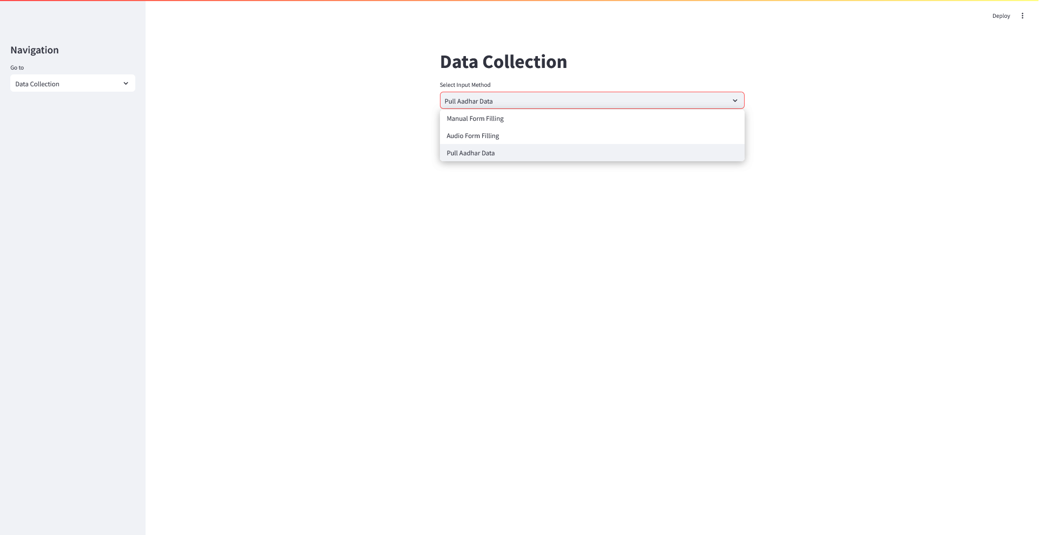
AI Powered HMS
GenAI-2024-2025-B2-00X
Application Screenshots
DATA COLLECTION PAGE

Slide 15
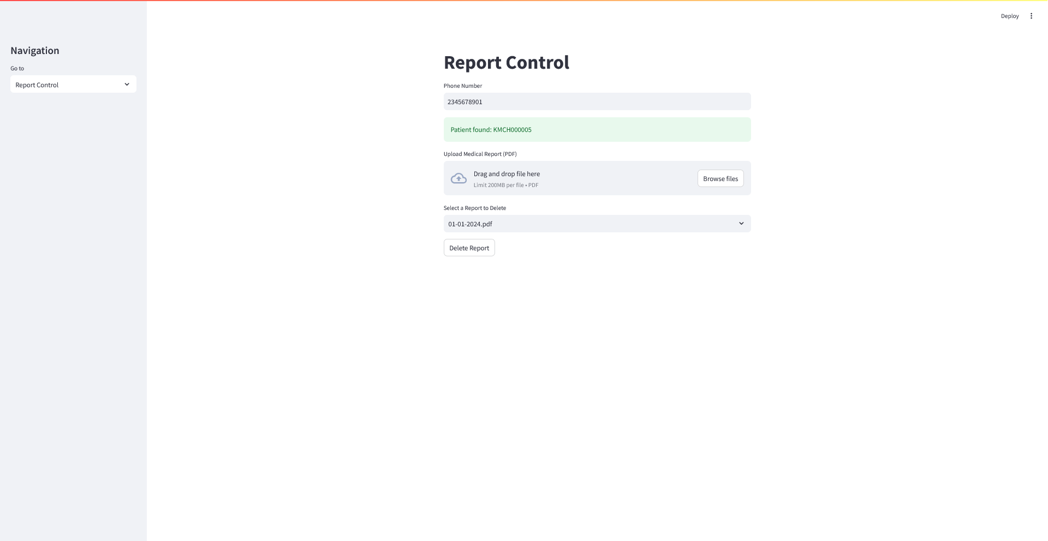
AI Powered HMS
GenAI-2024-2025-B2-00X
Application Screenshots
REPORT CONTROL PAGE

Slide 16
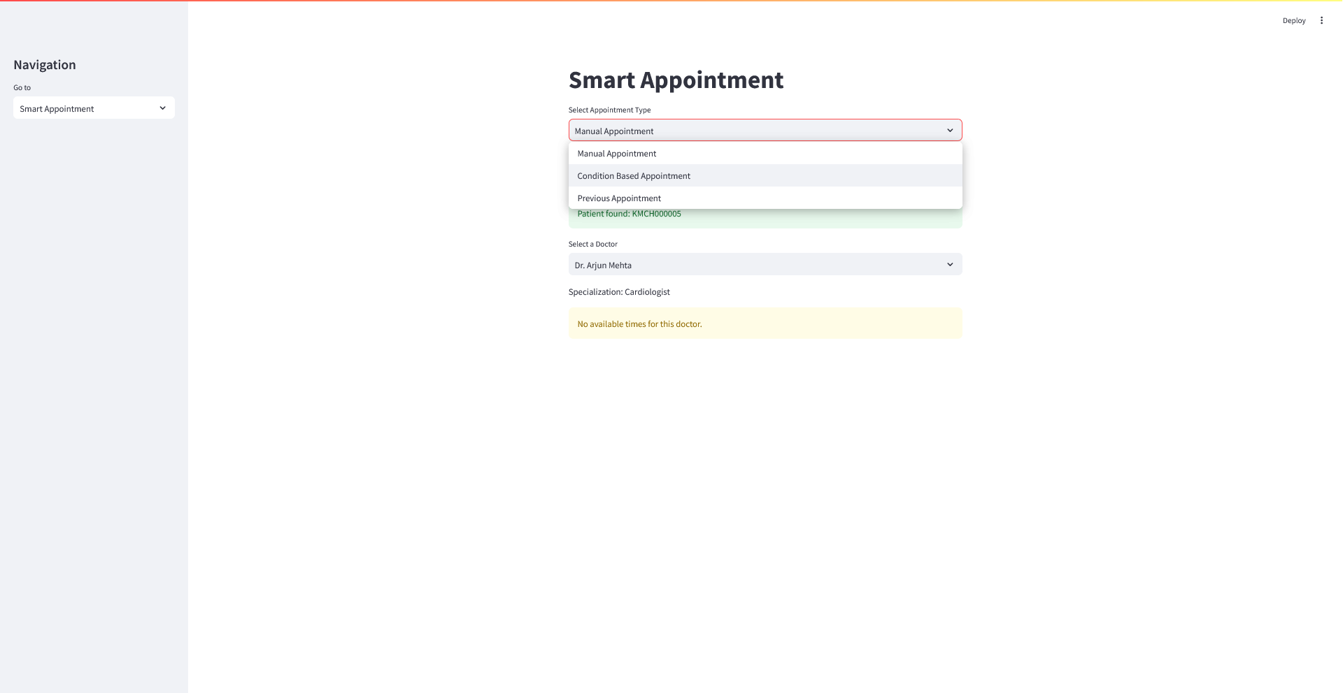
AI Powered HMS
GenAI-2024-2025-B2-00X
Application Screenshots
SMART APPOINTMENT PAGE

Slide 17
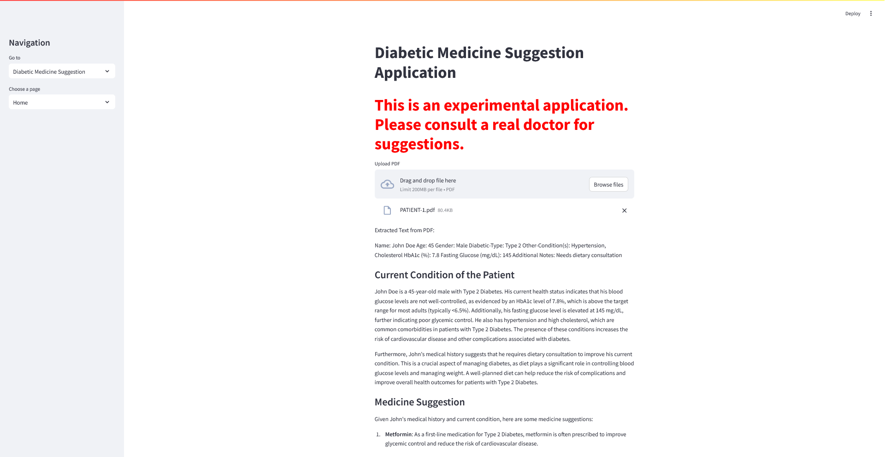
AI Powered HMS
GenAI-2024-2025-B2-00X
Application Screenshots
DIABETIC MEDICINE SUGGESTION

Slide 18
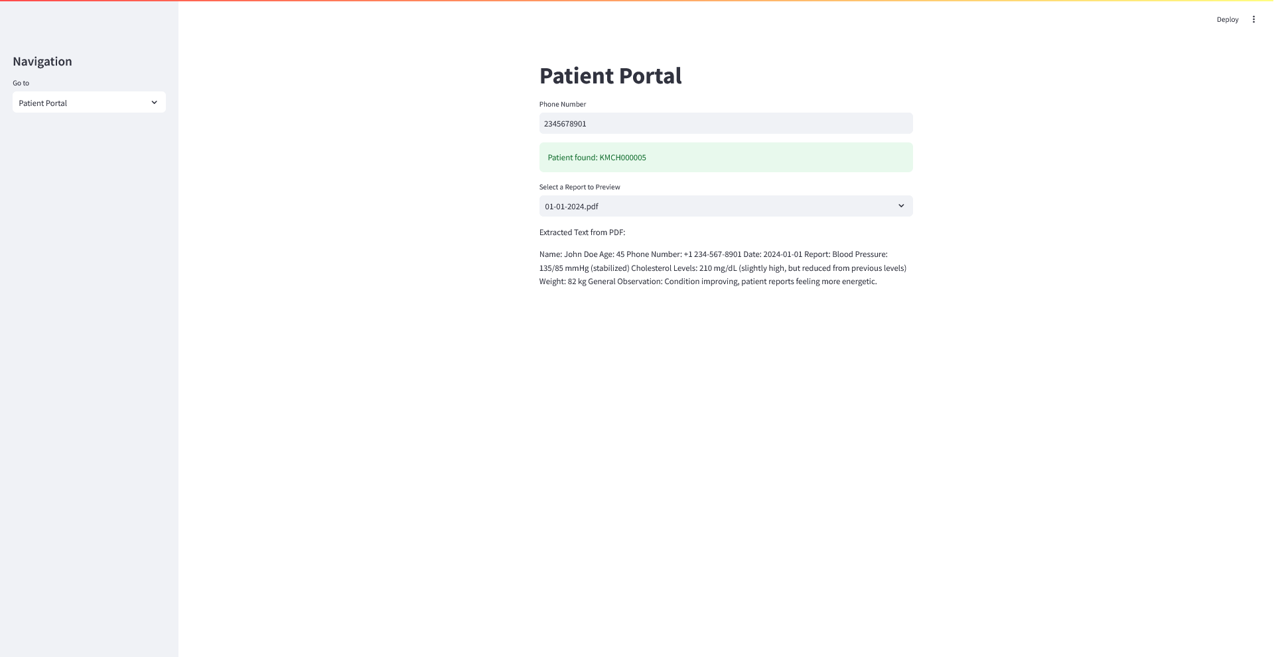
AI Powered HMS
GenAI-2024-2025-B2-00X
Application Screenshots
PATIENT PORTAL PAGE

Slide 19
AI Powered HMS
GenAI-2024-2025-B2-00X
Project / Product Roadmap
Project / Product Roadmap | Milestones | Features
Short Term | Mid Term | Long Term
Complete patient registration and data management features Implement AI for medical report generation | Develop intelligent appointment booking system Enhance doctor’s dashboard with treatment planning tools | Expand doctor’s dashboard with treatment planning tools

Slide 20
AI Powered HMS
GenAI-2024-2025-B2-00X
Artefacts
Project Portal
Wireframe | UI
Project Portal / website is available at Link
Project wireframe / UI designs are available at Link
Presentation
Application
Project presentation (this document) is available at Link
Application is available at Link
Requirement Document / Specification
DT Playbook
Project requirement document / specification is available at Link
Project DT Playbook is available at Link
Technical Document / Specification
Overview Video
Project technical document / specification are available at Link
Project overview video is available at Link
Video provides project overview, presentations, journey wise Wireframe, UI, application demo as required and as applicable.
Source Code
Project code repository is available at Link
Note: All links are provided as clickable hyperlink available as “Link”

Slide 21
AI Powered HMS
GenAI-2024-2025-B2-00X
Thanks
Thanks

